Slide 1
Week 9 lec 3 Week 10 lec 1

Slide 2
Diamond problem
In case of hybrid inheritance, a Diamond problem may arise. The “dreaded diamond” refers to a class structure in which a particular class appears more than once in a class’s inheritance hierarchy.
Consider the situation where we have one class A .This class is A is inherited by two other classes B and C. Both these class are inherited into another in a new class D as shown in figure below.

Slide 3
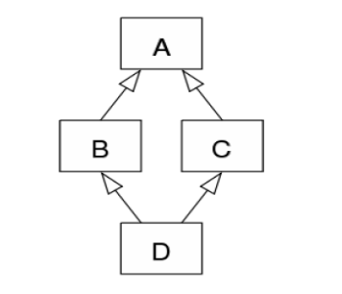
diamond problem

Slide 4
class A{
};
class B : public A{
};
class C : public A{
};
class D : public B , public C{
};
int main(){
cout << sizeof(A) << endl;
cout << sizeof(B) << endl;
cout << sizeof(C) << endl;
cout << sizeof(D) << endl;
}

Slide 5
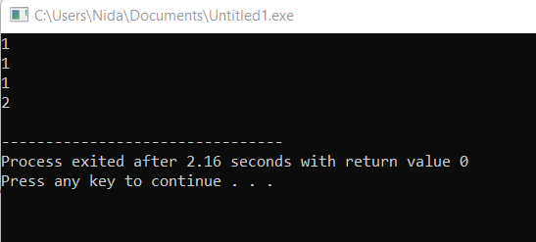

Slide 6
class A{
int a;
};
class B : public A{
};
class C : public A{
};
class D : public B , public C{
};
int main(){
cout << sizeof(A) << endl;
cout << sizeof(B) << endl;
cout << sizeof(C) << endl;
cout << sizeof(D) << endl;
}

Slide 7
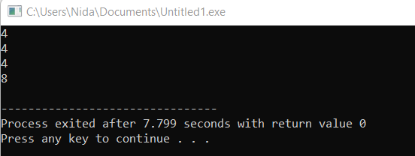

Slide 8
class A{
public:
int a;};
class B : public A{
public:
int b;};
class C : public A{
public:
int c;};
class D : public B , public C{
public:
int d;};
int main(){
cout << sizeof(A) << endl;
cout << sizeof(B) << endl;
cout << sizeof(C) << endl;
cout << sizeof(D) << endl;}

Slide 9
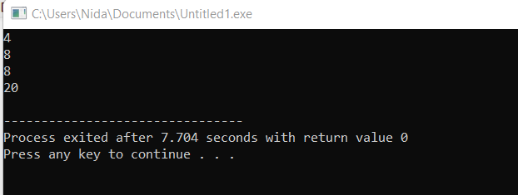

Slide 10
diamond problem
class A{
public:
int a;};
class B : public A{
public:
int b;};
class C : public A{
public:
int c;};
class D : public B , public C{
public:
int d;};

Slide 11
diamond problem
int main(){
D d;
d.a;
return 0;}

Slide 12
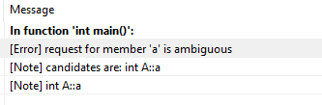
This problem is also known as diamond problem
From above example we can see that “A” is inherited two times in D means an object of class “D” will contain two attributes of “a” (D::C::a and D::B::a).

Slide 13
This problem is also known as diamond problem
As we can see from the figure that data members/function of class A are inherited twice to class D. One through class B and second through class C. When any data / function member of class A is accessed by an object of class D, ambiguity arises as to which data/function member would be called? One inherited through B or the other inherited through C. This confuses compiler and it displays error.

Slide 14
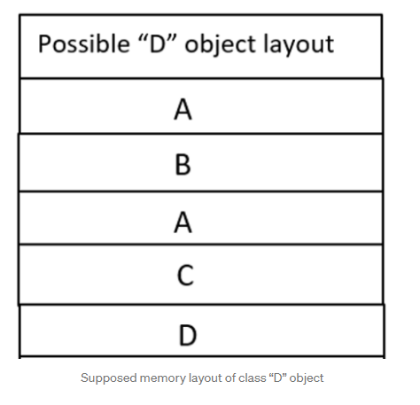
Memory layout of class “D” object:

Slide 15
How to resolve this issue?
To resolve this ambiguity when class A is inherited in both class B and class C, it is declared as virtual base class by placing a keyword virtual as :

Slide 16
How to resolve this issue?
There will be new virtual base pointers which would be inserted by compiler when we are using virtual inheritance.
This virtual base pointer will provide an indirect access to class “A” object
Identify the problematic class and use virtual keyword in all child classes that are associated with problematic class. In previous example problematic class is A that occurs more than once so inherit it by using virtual keyword

Slide 17
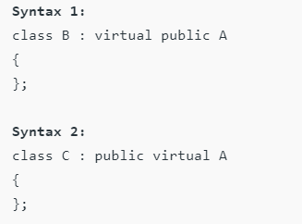
virtual base class / virtual inheritance

Slide 18
virtual base class / virtual inheritance
Virtual base classes offer a way to save space and avoid ambiguities in class hierarchies that use multiple inheritances. When a base class is specified as a virtual base, it can act as an indirect base more than once without duplication of its data members. A single copy of its data members is shared by all the base classes that use virtual base.

Slide 19
virtual base class / virtual inheritance
which single copy of its data members is shared?
both base classes (class B and class C) use virtual base.

Slide 20
virtual base class / virtual inheritance
it varies from compiler to compiler
Depends on compiler which path is selected to access grand parents' data from grand child
Usually, Last updated copy of its data members is shared by all the base classes that use virtual base
The right most class being inherited is the one who's data member is going to come in derived class

Slide 21
virtual base class / virtual inheritance
class A {
public:
int a;
A() {
a = 10; }};
class B : public virtual A {
public:
B() {
a ++; }};
class C : public virtual A {
public:
C() {
a ++;}};
class D : public B ,public C {
};

Slide 22
virtual base class / virtual inheritance
int main()
{
D object; // object creation of class d
cout << "a = " << object.a << endl;
return 0;
}

Slide 23
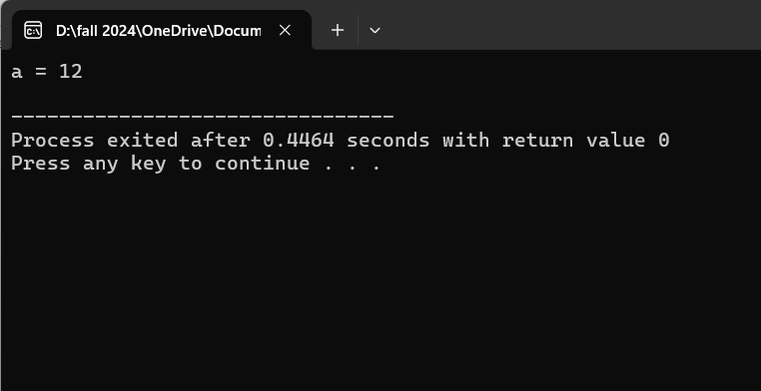
virtual base class / virtual inheritance

Slide 24
virtual base class / virtual inheritance
class A {
public:
int a;
A() {
a = 10; }};
class B : public virtual A {
public:
B() {
a = 1; }};
class C : public virtual A {
public:
C() {
a = 2;}};
class D : public C , public B {
};

Slide 25
virtual base class / virtual inheritance
int main()
{
D object; // object creation of class d
cout << "a = " << object.a << endl;
return 0;
}

Slide 26
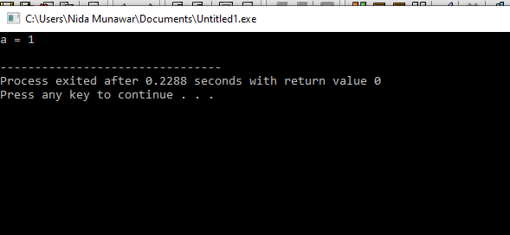
virtual base class / virtual inheritance

Slide 27
virtual base class / virtual inheritance
class D : public C , public B {
public:
D() {
a = 5;} // now the last updated value will be 5
getval(){
cout << a;}};

Slide 28
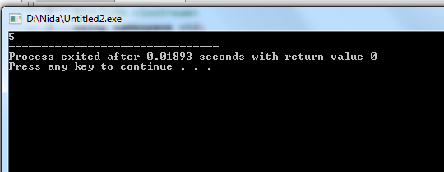
virtual base class / virtual inheritance

Slide 29
virtual base class / virtual inheritance
#include <iostream>
using namespace std;
class A {
public:
int a;
A() {
a = 10; }
getval(){
cout << a;
}};

Slide 30
virtual base class / virtual inheritance
class B : public virtual A {
public:
B() {
a = 1;
}
getval(){
cout << a;
}};

Slide 31
virtual base class / virtual inheritance
class C : public virtual A {
public:
C() {
a = 2;}
getval(){
cout << a;}};
class D : public C , public B {
public:
getval(){
C::getval();} // we are expecting it’ll print 2

Slide 32
virtual base class / virtual inheritance
};
int main()
{
D object; // object creation of class d
object.getval();
return 0;
}

Slide 33
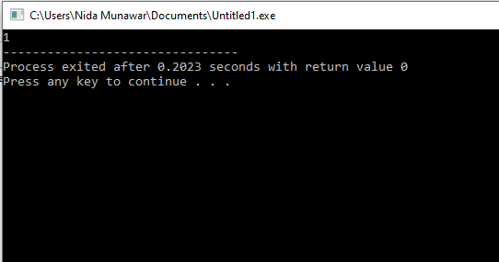
Remember it will take rightmost inherited value of class B because we use virtual

Slide 34
Explanation
You created object of class D compiler will choose one path from grand child to grand parent either from Class B or Class C
In this case compiler will choose right most inherited class that is class B and print the value accordingly that’s why it will hide the value updated in Class C
If you want to access the updated value of class C you have to create the object of class C instead of class D it works normally

Slide 35
class A {
public:
int a;
A() {
cout << "A" << endl; }};
class B : public A {
public:
B() {cout << "B" << endl; }};
class C : public A {
public:
C() {cout << "C" << endl;}};
class D : public B ,public C {
public:
D() {cout << "D" << endl;}};
int main(){
D object; // object creation of class d
return 0;}

Slide 36
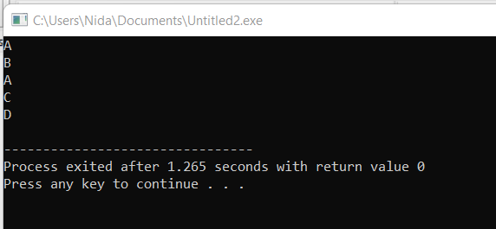

Slide 37
Without virtual
class A {
public:
A(int a) {
cout << a << endl; }};
class B : public A {
public:
B():A(2) { }};
class C : public A {
public:
C():A(3) {}};
class D : public B ,public C {
public:
D() { }};
int main(){
D object; // object creation of class d
return 0;}

Slide 38
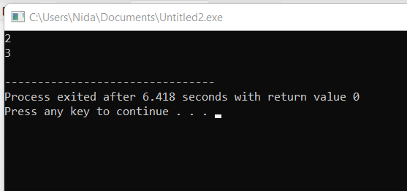

Slide 39
With virtual
class A {
public:
A(int a) {
cout << a << endl; }};
class B : virtual public A {
public:
B():A(2) { }};
class C : virtual public A {
public:
C():A(3) {}};
class D : public B ,public C {
public:
D() { }};
int main(){
D object; // object creation of class d
return 0;}

Slide 40
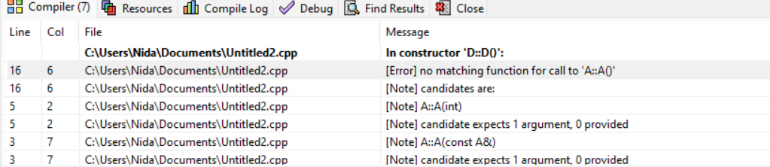

Slide 41
Now D is responsible to give value to its indirect parent class
#include <iostream>
using namespace std;
class A {
public:
A(int a) {
cout << a << endl; }};
class B : virtual public A {
public:
B():A(2)//compiler will ignore this but you cannot skip this line for hirarichal inheritance { }};
class C : virtual public A {
public:
C():A(3)//compiler will ignore this but you cannot skip this line for hirarichal inheritance {
}};

Slide 42
class D : public B ,public C {
public:
D():A(1) { }};
int main()
{
D object; // object creation of class d
return 0;
}

Slide 43
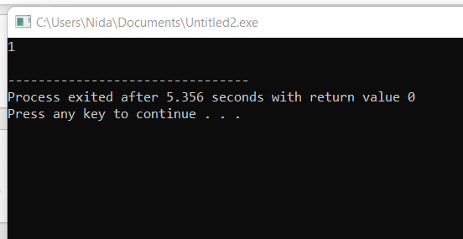

Slide 44
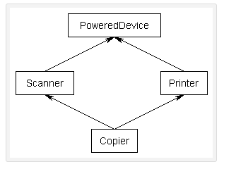
Identify the problematic class?

Slide 45
Identify the problematic class through parametrized constructor ?
class PoweredDevice{
public:
PoweredDevice(int power){
cout << "PoweredDevice: " << power << '\n';}};
class Scanner: public PoweredDevice{
public:
Scanner(int scanner, int power)
: PoweredDevice(power) {
cout << "Scanner: " << scanner << '\n'; }};

Slide 46
Identify the problematic class through parametrized constructor ?
class Printer: public PoweredDevice{
public:
Printer(int printer, int power)
: PoweredDevice(power) {
cout << "Printer: " << printer << '\n'; }};
class Copier: public Scanner, public Printer{
public:
Copier(int scanner, int printer, int power)
: Scanner(scanner, power), Printer(printer, power) {
}};

Slide 47
Identify the problematic class through parametrized constructor ?
int main()
{
Copier copier(1, 2, 3);
return 0;}
If you were to create a Copier class object, by default you would end up with two copies of the PoweredDevice class -- one from Printer, and one from Scanner. This has the following structure:

Slide 48
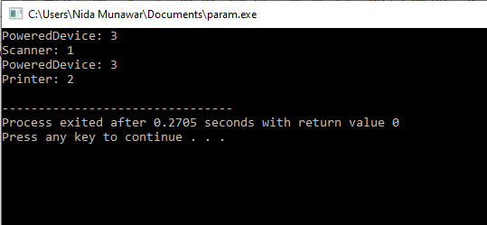
Identify the problematic class through parametrized constructor ?

Slide 49
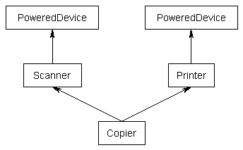
Identify the problematic class through parametrized constructor ?

Slide 50
Solution By using Virtual Base class
#include <iostream>
class PoweredDevice {
public:
PoweredDevice(int power) { std::cout << "PoweredDevice: " << power << '\n'; }};
class Scanner: virtual public PoweredDevice
{
public:
Scanner(int scanner, int power)
: PoweredDevice(power) // this line is required to create Scanner objects, but ignored in this case because we are working with copier object
{ std::cout << "Scanner: " << scanner << '\n'; }};

Slide 51
Solution By using Virtual Base class
class Printer: virtual public PoweredDevice // note: PoweredDevice is now a virtual base class
{
public:
Printer(int printer, int power)
: PoweredDevice(power) // this line is required to create Printer objects, but ignored in this case because we are working with copier object
{ std::cout << "Printer: " << printer << '\n';
}};

Slide 52
Solution By using Virtual Base class
class Copier: public Scanner, public Printer
{
public:
Copier( int scanner ,int printer, int power)
: PoweredDevice(power), // PoweredDevice is constructed here updated value is provided by grandchild
Scanner(scanner, power),Printer(printer, power)
{
}
};
int main()
{
Copier copier(1, 2, 3);
return 0;}

Slide 53
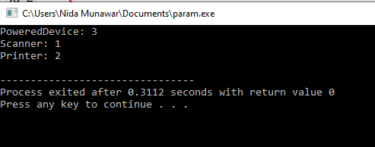
Solution By using Virtual Base class

Slide 54
Solution By using Virtual Base class
Now, when you create a Copier class object, you will get only one copy of PoweredDevice per Copier that will be shared by both Scanner and Printer.
However, this leads to one more problem: if Scanner and Printer share a PoweredDevice base class, who is responsible for creating it? The answer, as it turns out, is Copier. The Copier constructor is responsible for creating PoweredDevice. Consequently, this is one time when Copier is allowed to call a non-immediate-parent constructor directly if we not use virtual here we cannot access non-immediate-parent directly it will cause an compile time error

